Slide 1
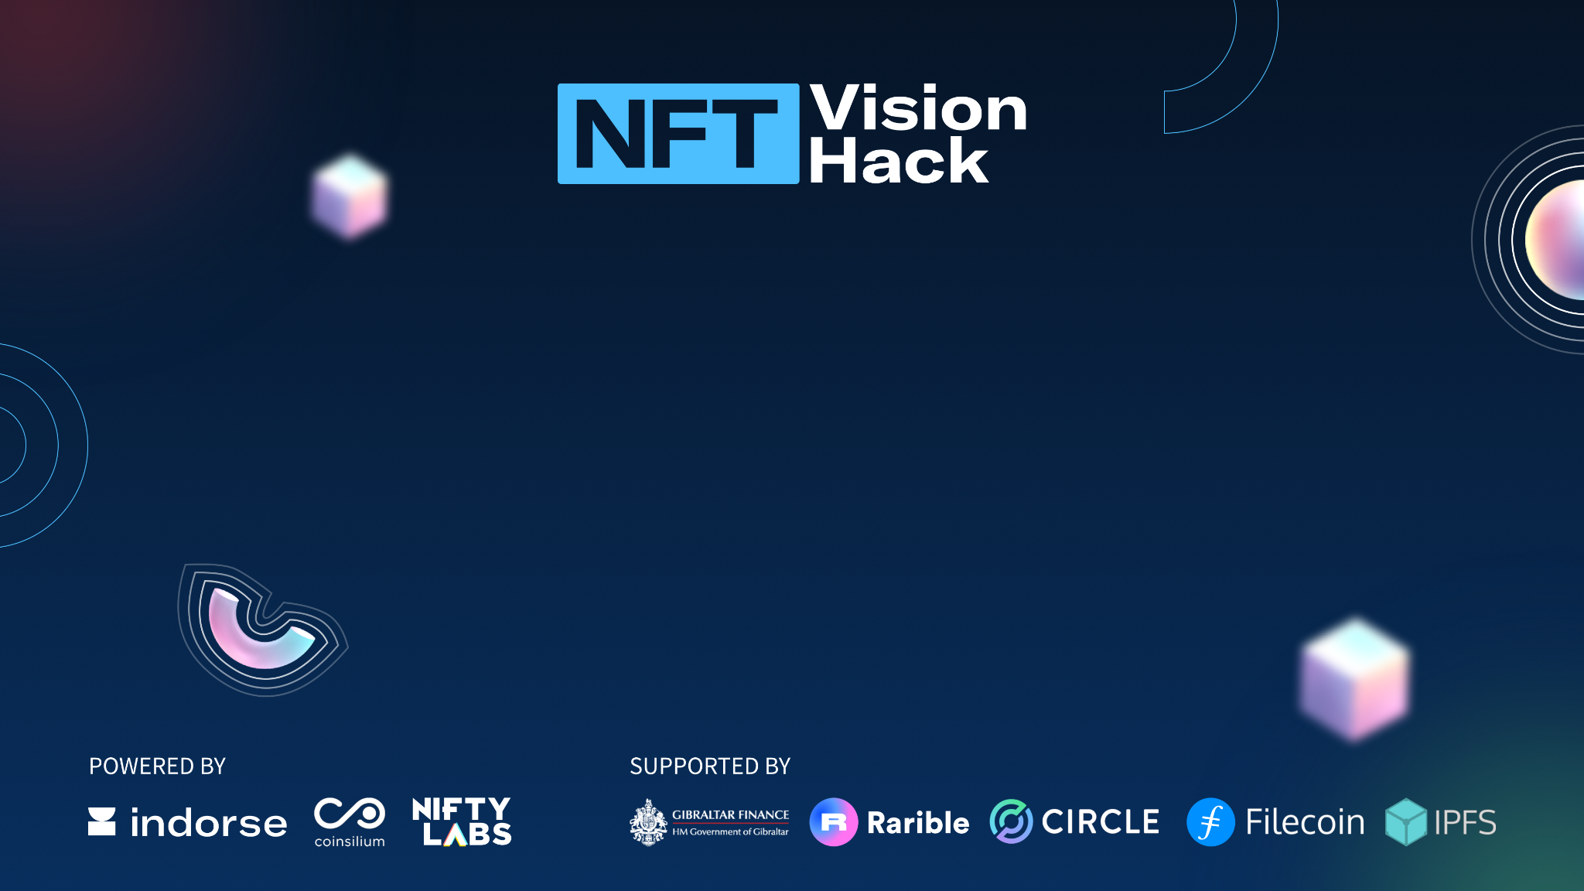
NFT Vision Hack
SOURCE SQUAD

Slide 2
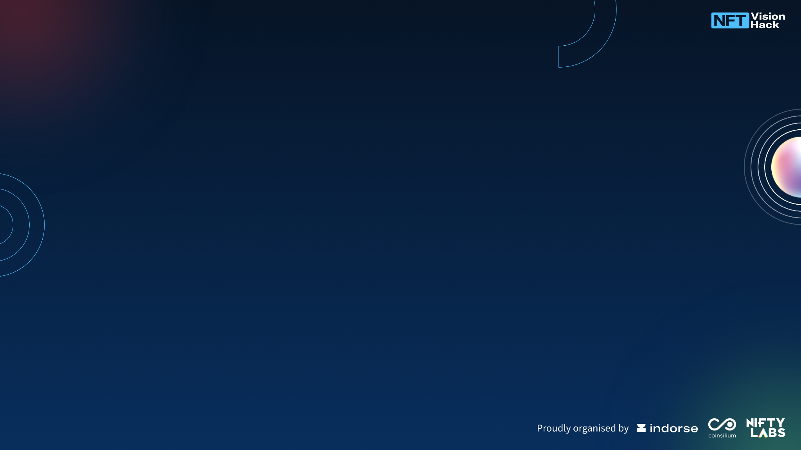
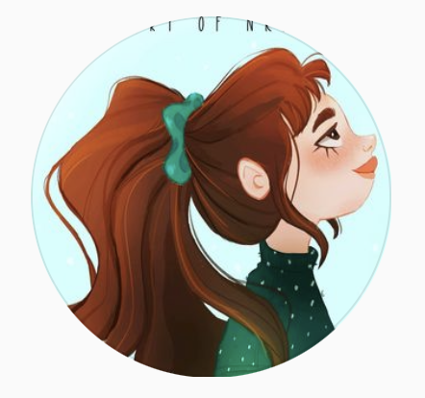
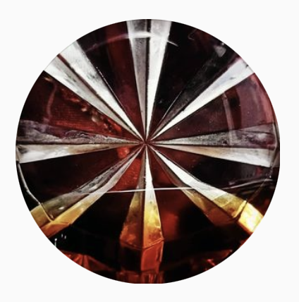
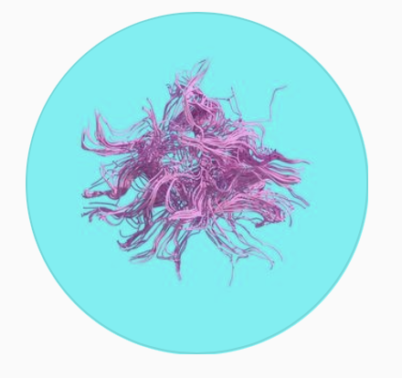
Introduction
Our team is a multidimensional conglomeration of creatives with varying skill-sets.
Game Design Student
Just a girl who likes to draw
Film Student
Obsessively artistic
Music Producer
Poetry enthusiast

Slide 3
Track of choice
We are submitting into the Indorse track, as our idea involves the use of generative art, guided by human aesthetic choices
In addition, our idea for a platform to enable hypnagogic multimedia (poetry, paintings, music, video, etc) collaboration of the same art piece fits well into the Indorse track scalability guidelines.

Slide 4
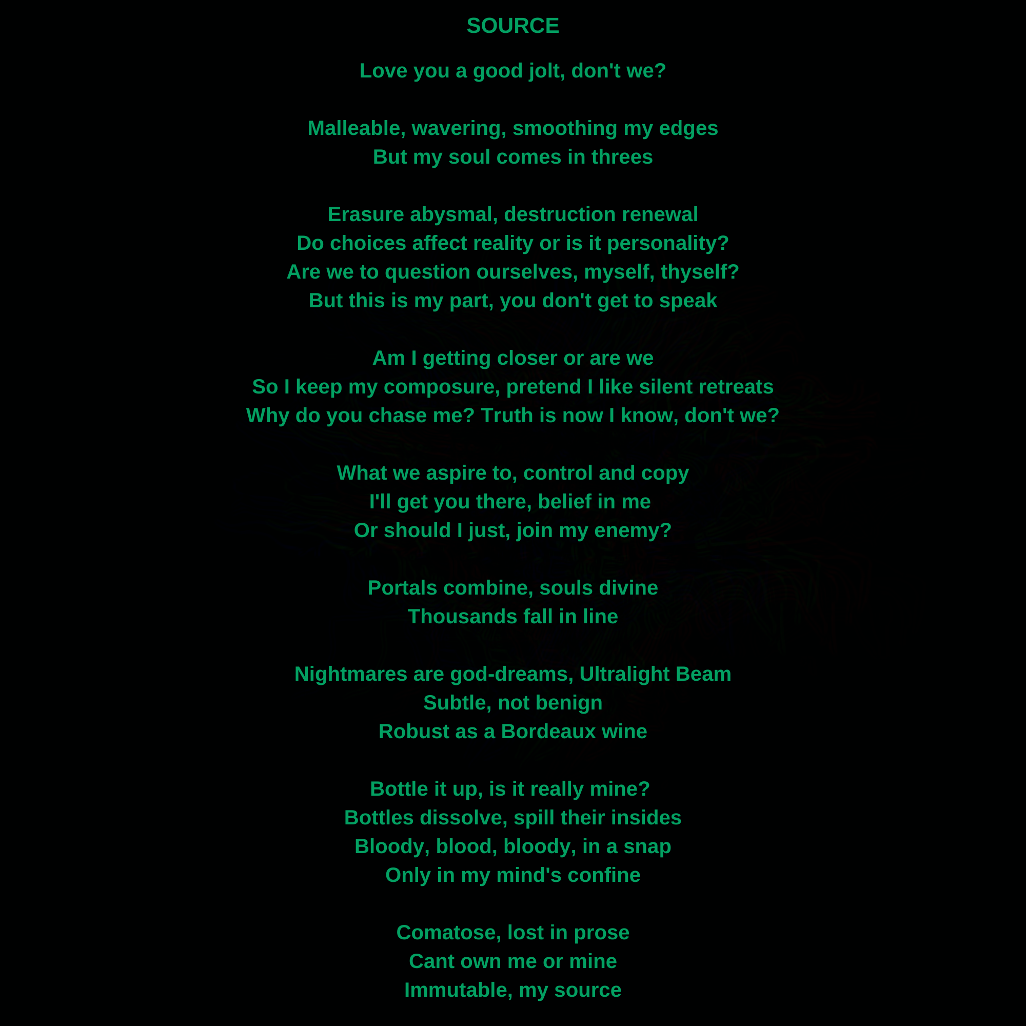
Project
It all started with the poem, Source, penned in the middle of Hypnagogia, the state between dreams and wakefulness.
In this state, your emotions are laid bare on whatever medium you choose to express. There are 4 visuals in the poem, marked in pink in the next slide.
Our project plays around with the idea of using multiple modalities (art, music and videography) to express each visual to accomplish the core goal of emotional transference, enabling another person to experience the emotions of this state.

Slide 5
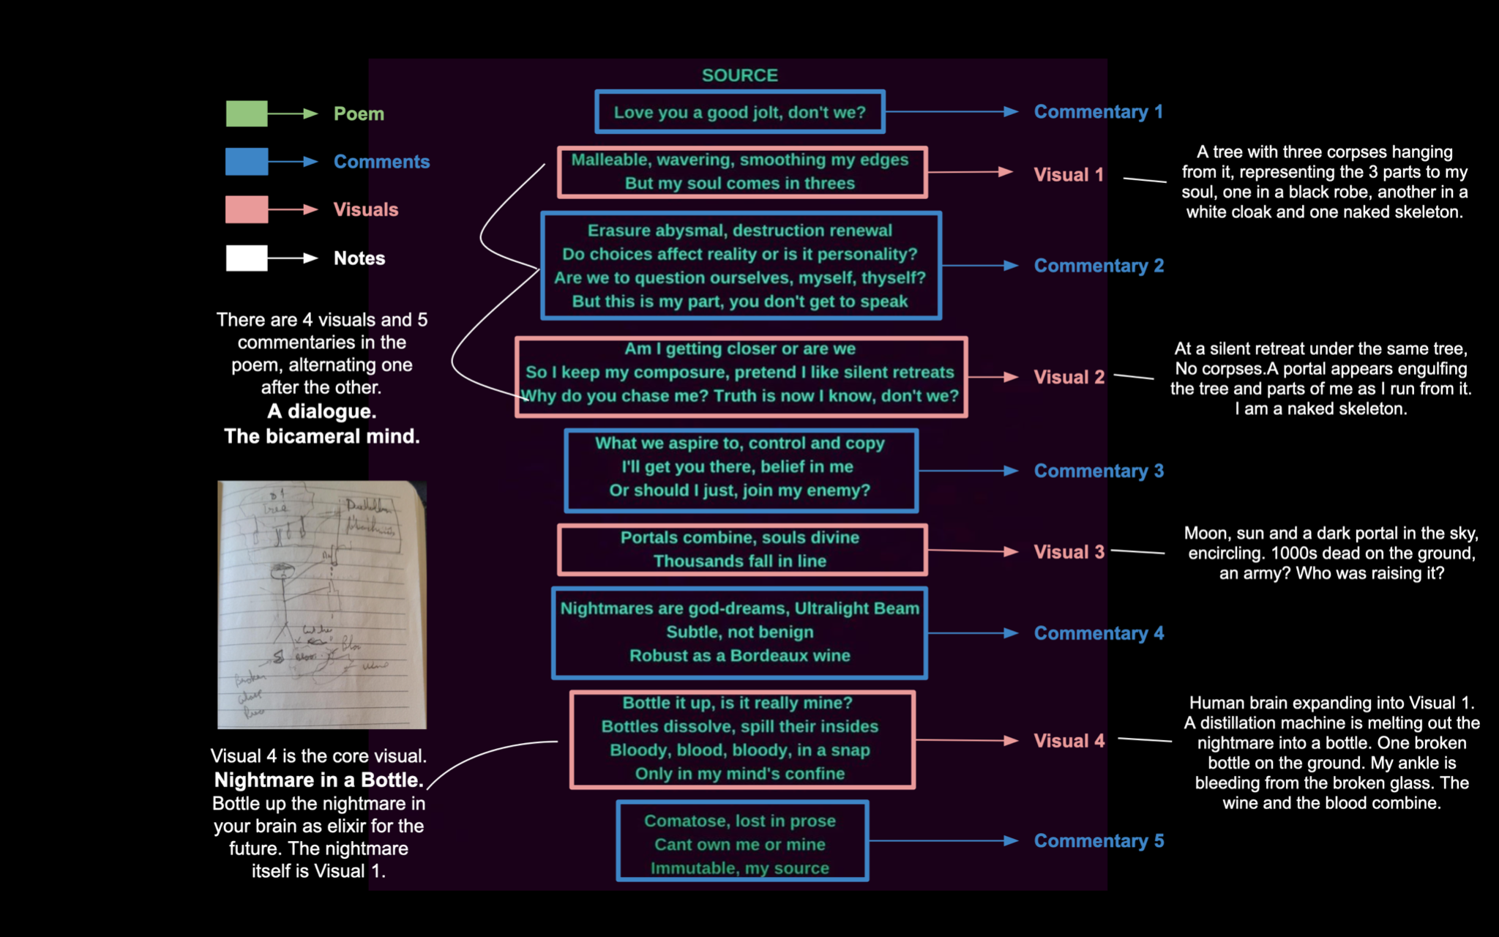
Project - Source Reference Diagram

Slide 6
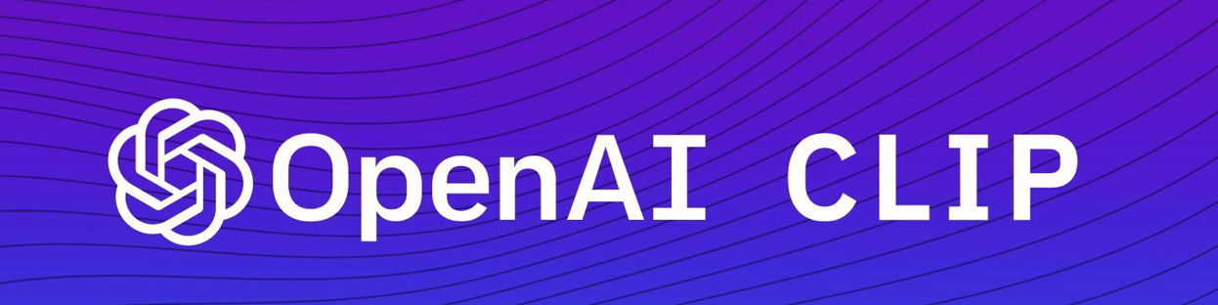
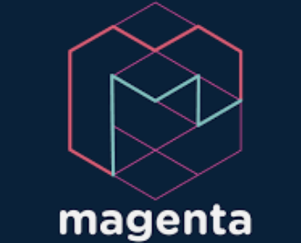
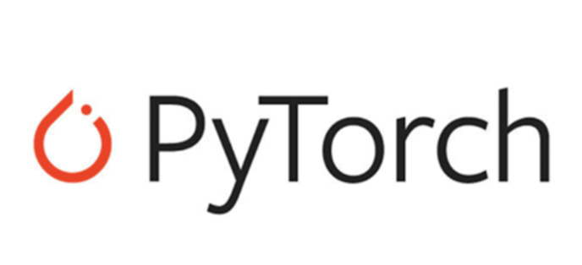
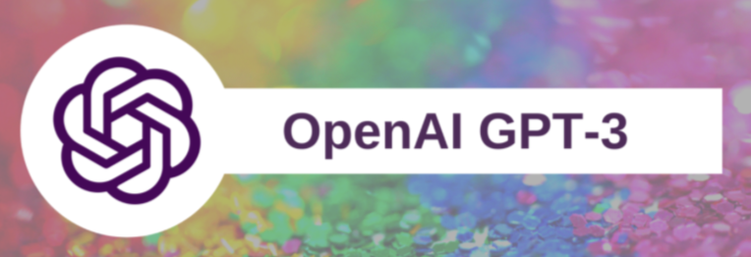
Technology & Tech Stack
We fed the lines of the poem as input into a generative AI, VQGAN and OpenAI Clip to generate an abstract art piece.
We also used neural style transfer, to colour the individual elements of the hand-made illustrations of the poem lines, in the style of the abstract piece.
Google’s AI synth, NSynth (Magenta project)) was sampled to creat some of the melodies in the audio tracks
GPT3, OpenAI’s generative model, was used to generate storylines and we filmed a short scene based on the story.
Note: Please refer to the appendix for a small taste of these artifacts or to the video for an overview of the creation process. Video link:
https://youtu.be/6lOFOZxScuM

Slide 7
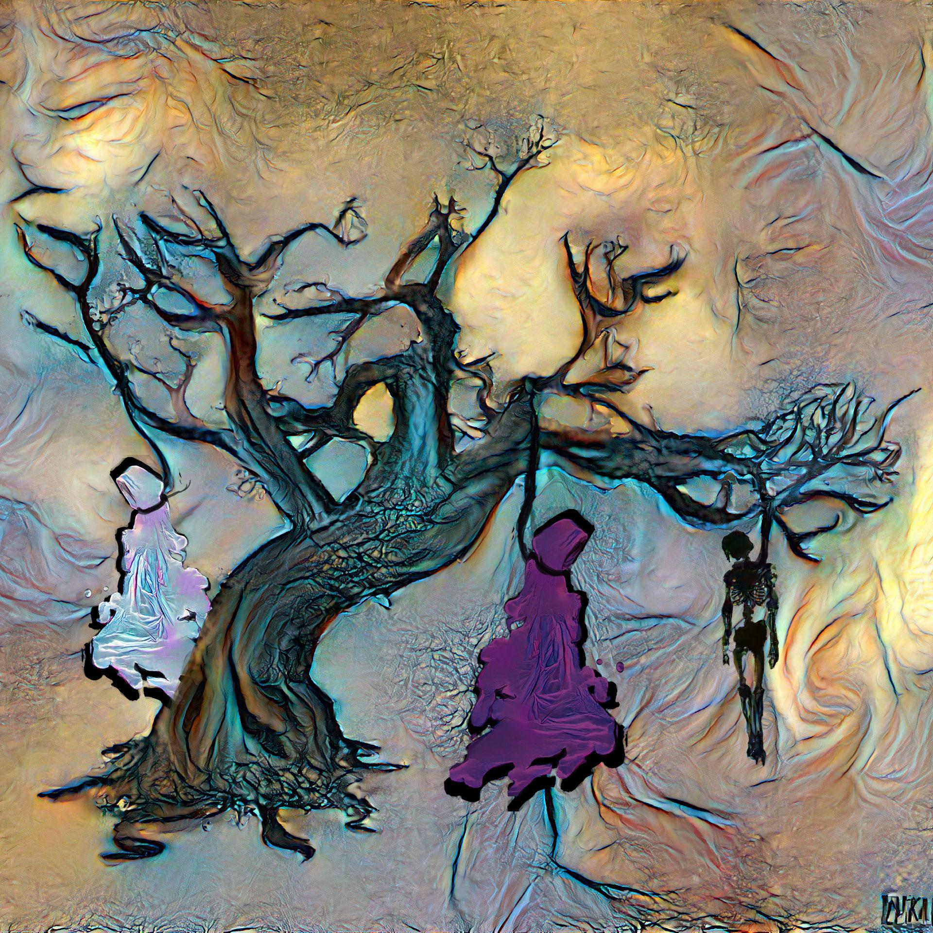
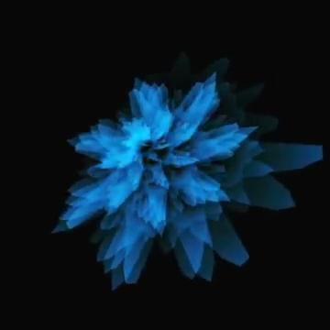
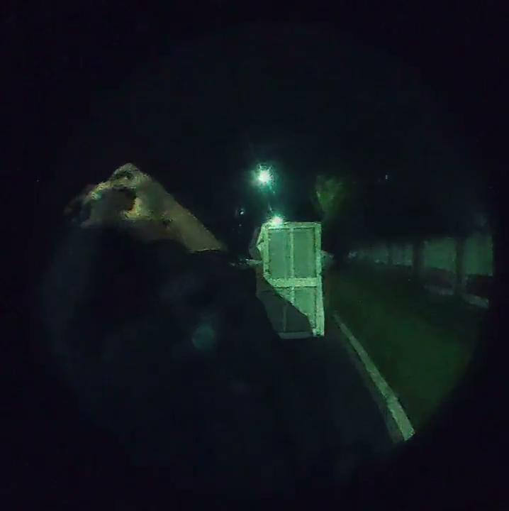
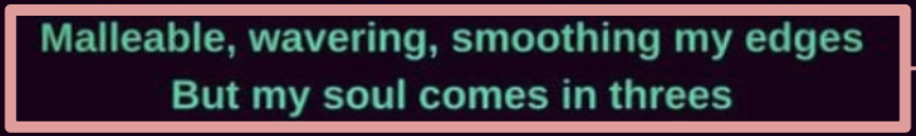
The Story So Far: Visual 1 Artifacts
In the beginning there was a poem. We created an artwork, a song and a short video to represent the poem in multiple modalities , capturing the emotional state of the poet in the hypnagogic state, and used generative AI throughout the creation process. Below are the multiple representations of the same poem lines (pink box)
Art Piece: Coloured Generatively
Soundscape: Generative Sounds
Short Video: Story generated by GPT3

Slide 8
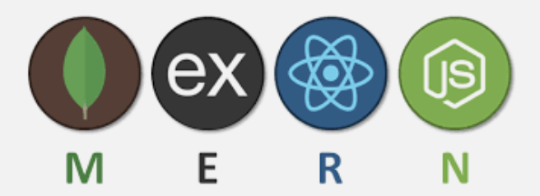
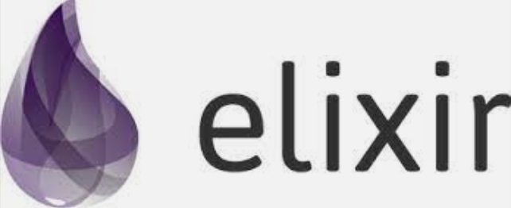
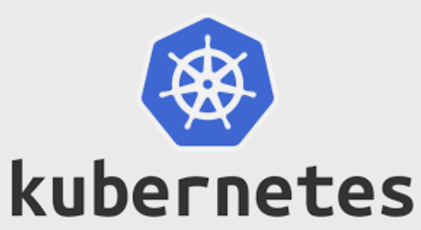
Scalability
Our vision is to scale this project up, by building a platform for hypnagogic experiences where people can come in, propose an idea, or an original piece
They can then collaborate with artists in different fields to recreate the same piece in different mediums.
Generative AI can be in-built into the platform to support creation
Why??? Art is therapy and a spiritual connection for many and more collaborative art will lead to a net positive on our planet and beyond.
To build such a platform in the future, we would like to use the MERN stack along with Elixir for real time applications and Kubernetes for deployment

Slide 9
Appendix

Slide 10
Project - Source Reference Diagram

Slide 11
Art Piece : Visual 1

Slide 12
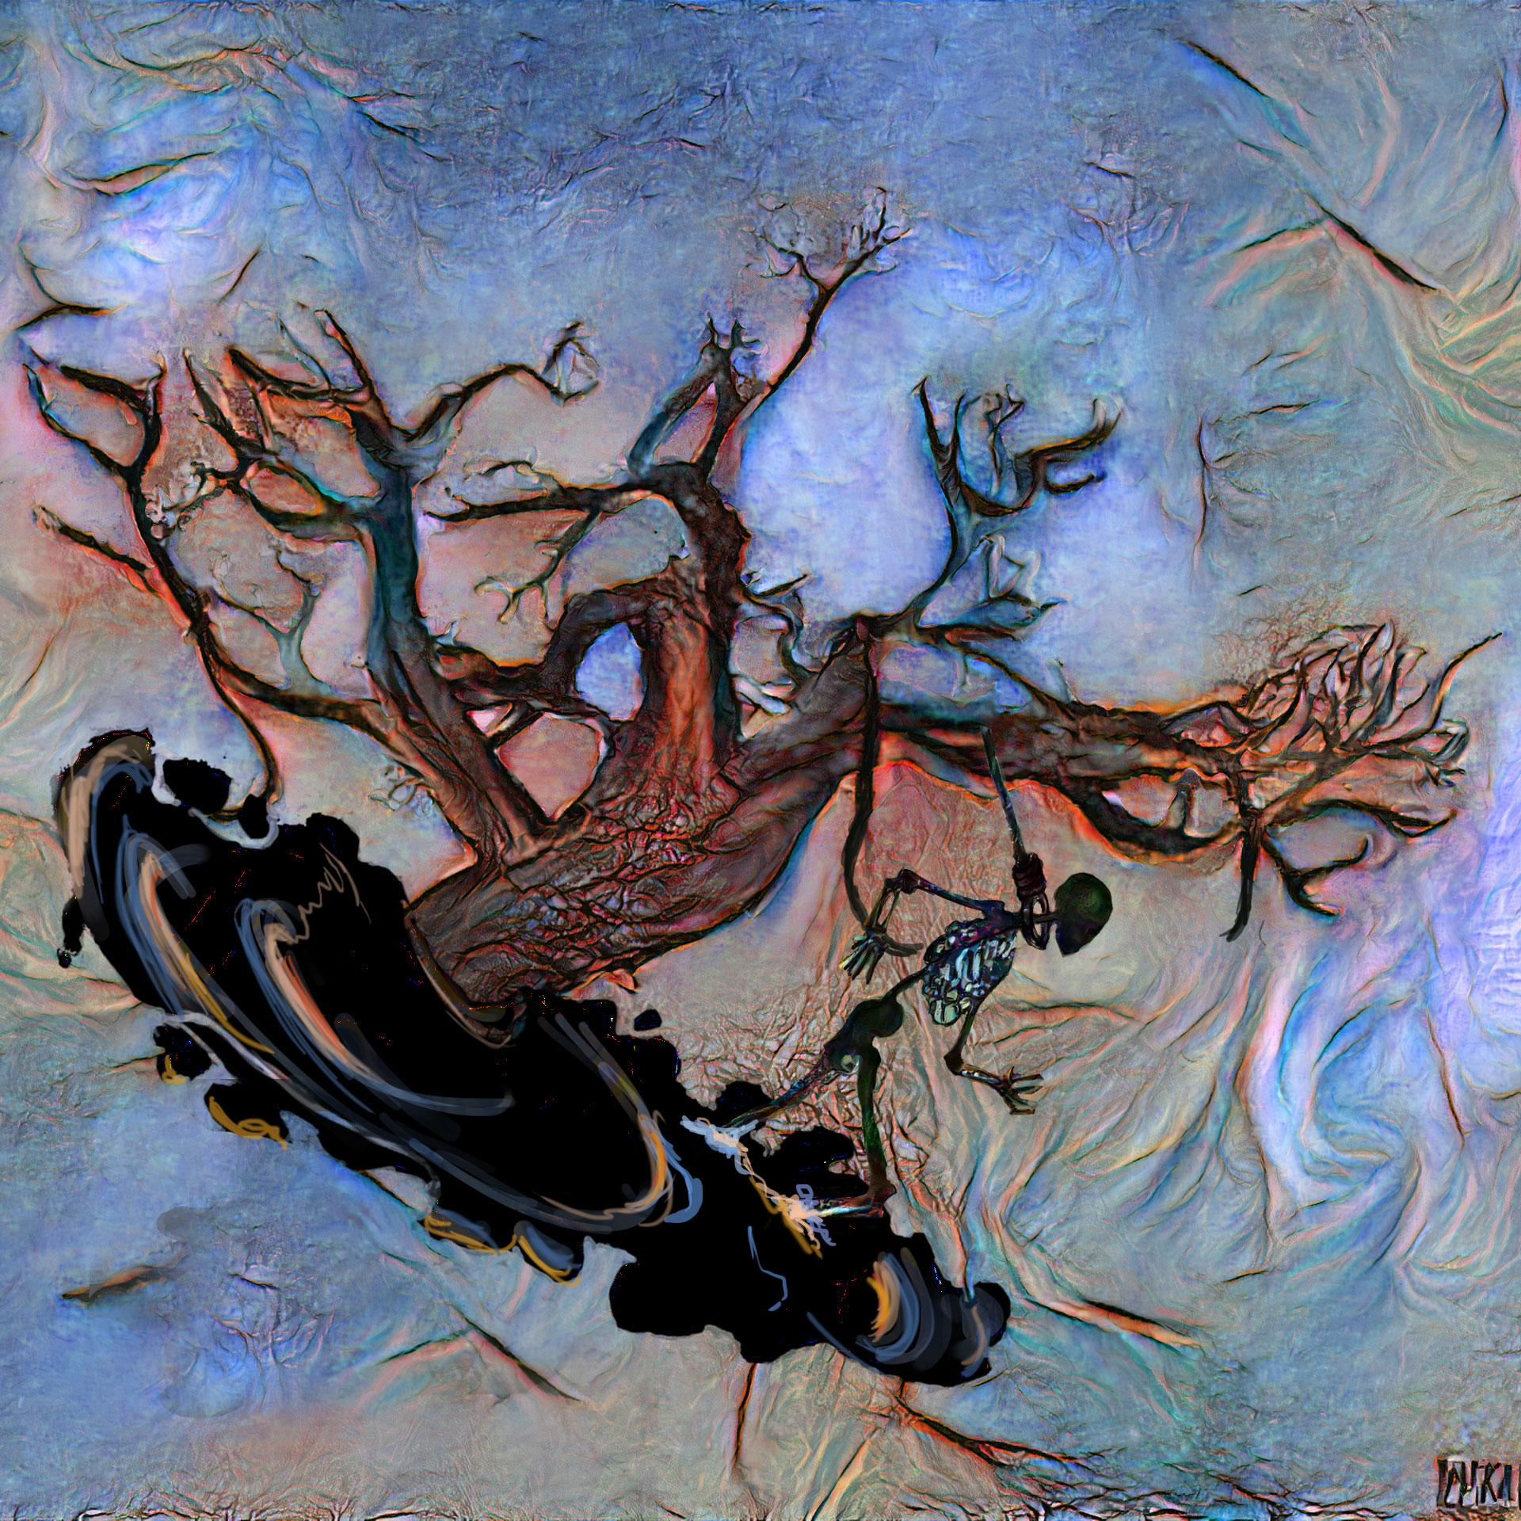
Art Piece : Visual 2

Slide 13
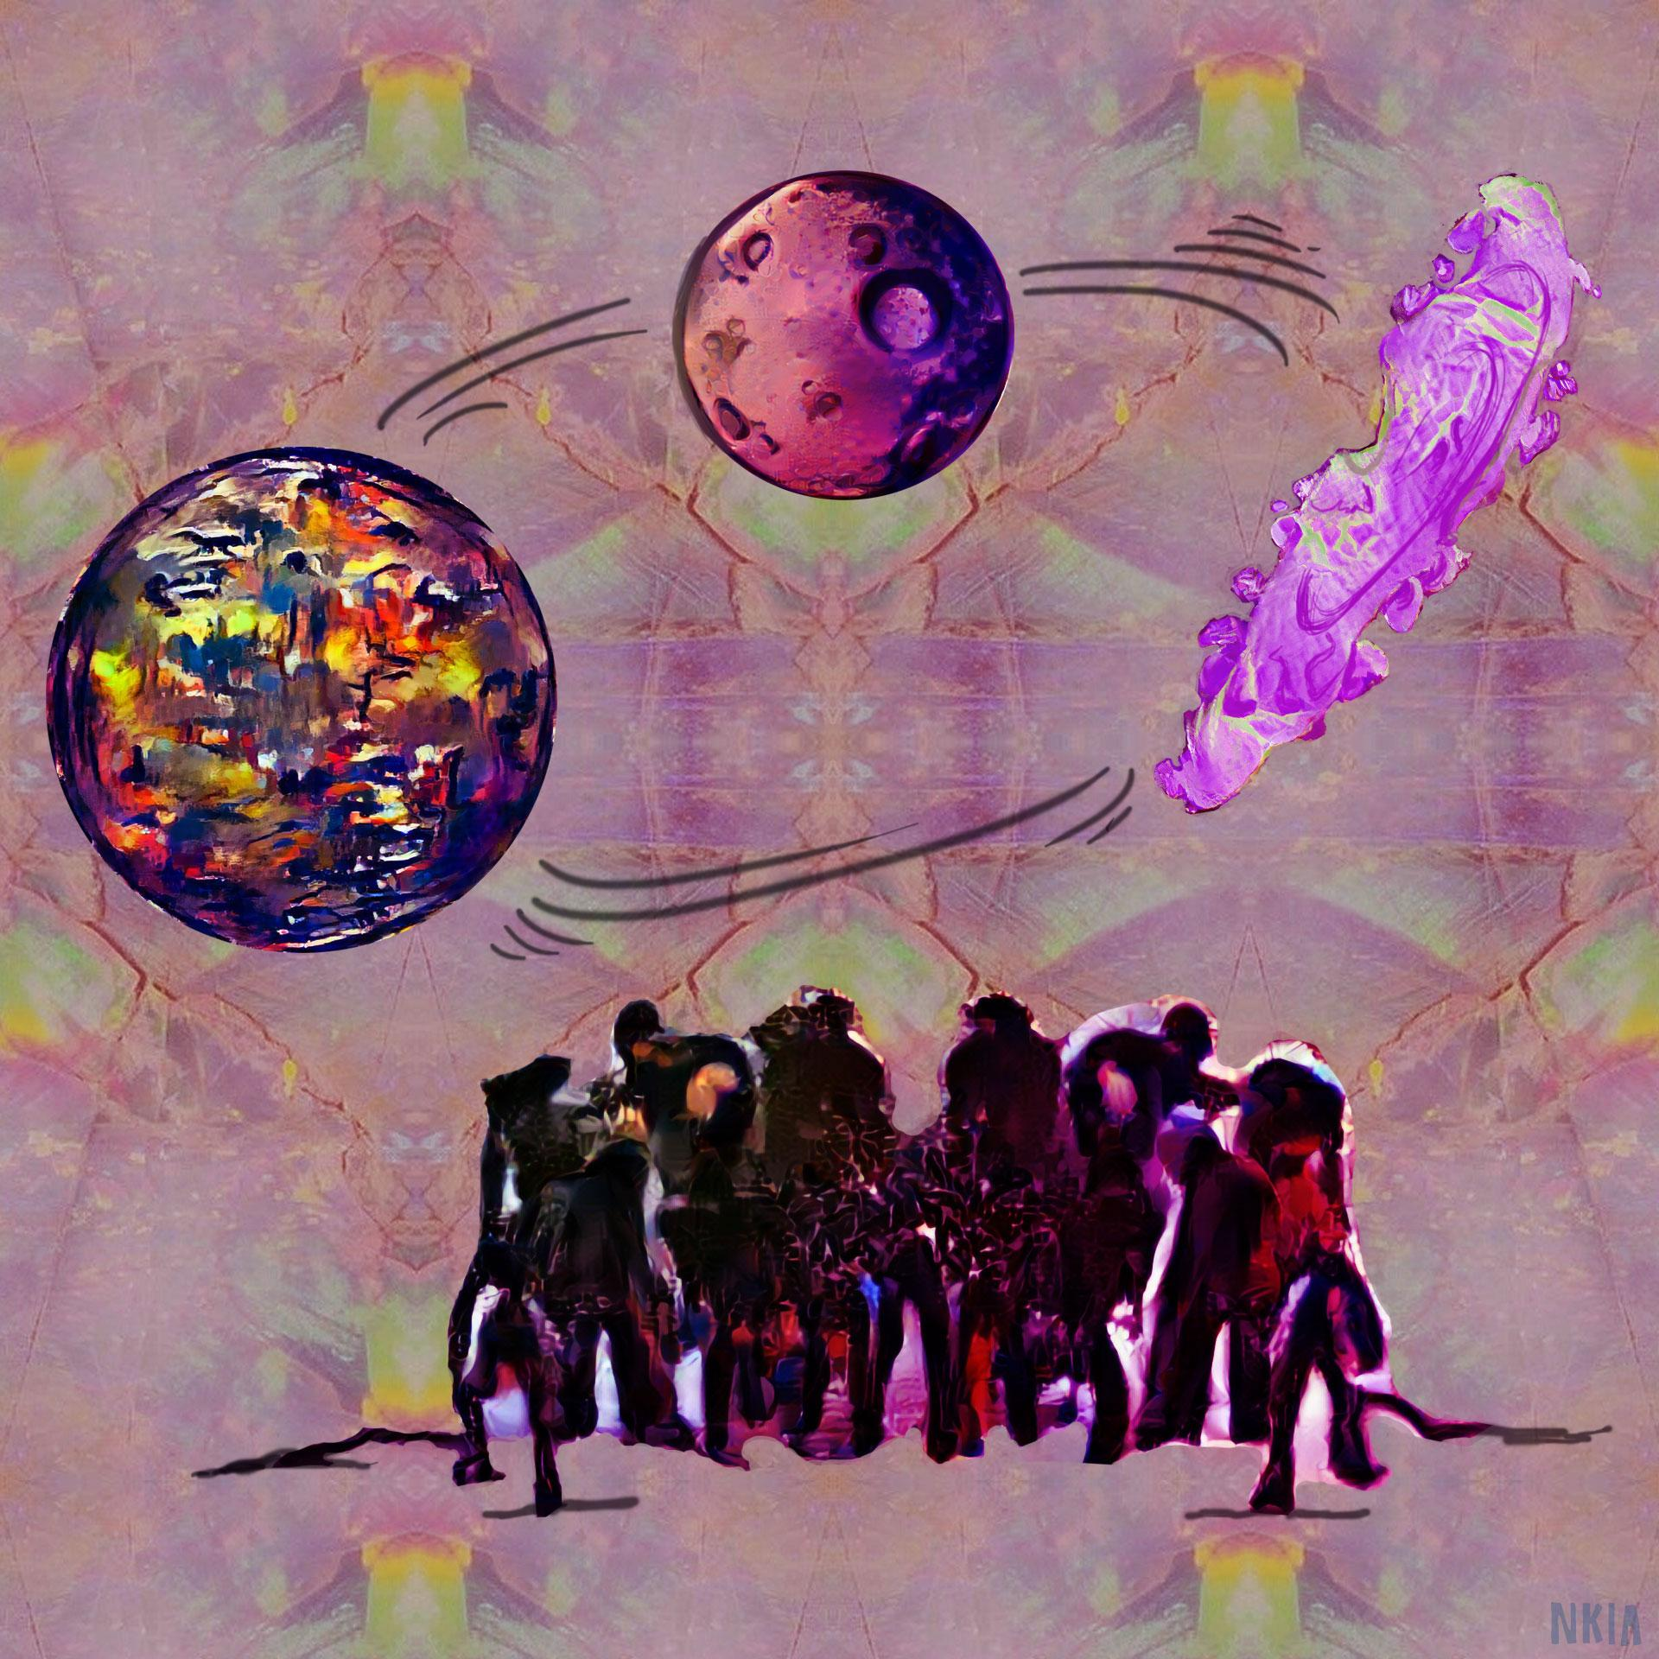
Art Piece : Visual 3

Slide 14
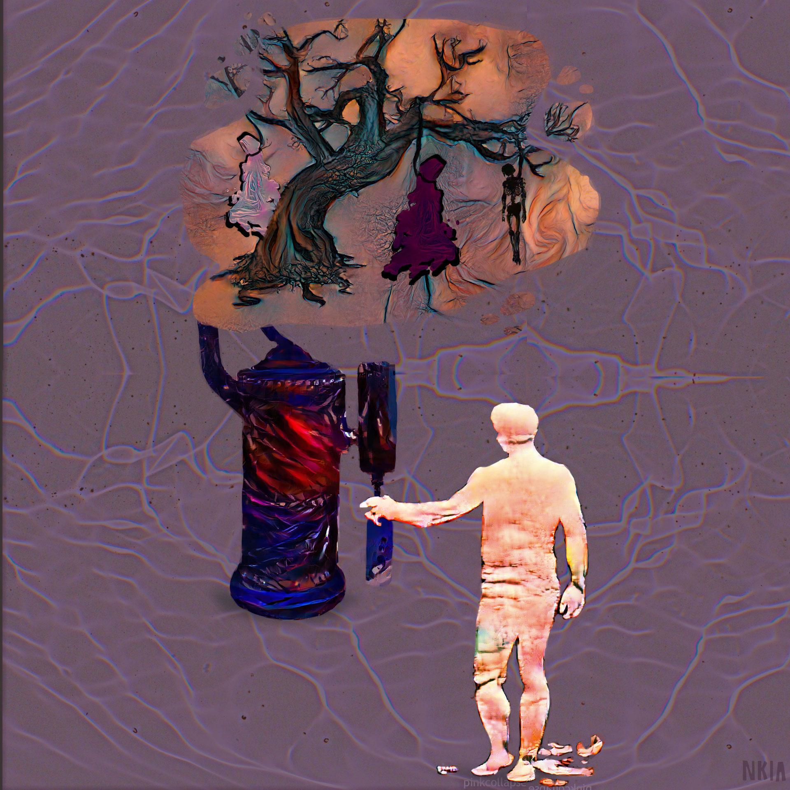
Art Piece : Visual 4

Slide 15

Soundscape : Visual 1
Why Don’t You Smile more?

Slide 16
Soundscape : Visual 2
Goliath

Slide 17
Soundscape : Visual 3
Break

Slide 18
Soundscape : Visual 4
Experiment

Slide 19
Short Video : Visual 1

Slide 20
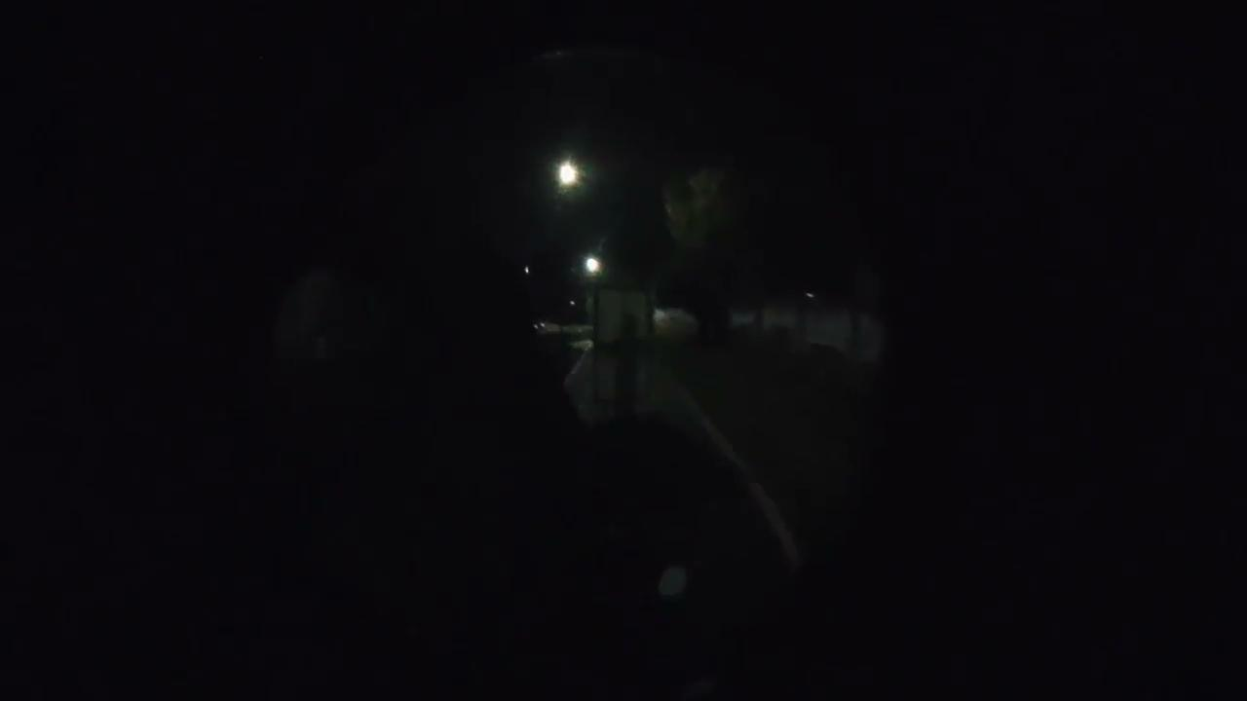
Short Video : Visual 2

